Slide 1


Generating Multi-scale Graphs with Graph U-Net
Department of Software Engineering Capstone Project Phase A Braude College of Engineering, Israel Project 24-1-R-9
Shachar Dalal Shahar Vachiler 205799976 314761065
Supervisor - Prof. Zeev Volkovich
Notes:
דלאל

Slide 2
Agenda
Introduction
Graph U-Nets
Model
Conclusion
Notes:
דלאל

Slide 3
Introduction
Graph generation involves creating mathematical structures modeling relationships between objects.
This process finds wide application in social network analysis, bioinformatics, recommendation systems, chemical compound generation, and traffic flow modeling.
By generating graphs representing these systems, researchers and practitioners can gain valuable insights that aid decision-making processes.

Slide 4
Introduction
Graph generation involves creating mathematical structures that model relationships between objects.
This is essential for applications like social network analysis, bioinformatics, recommendation systems, chemical compound generation, and traffic flow modeling.
However, capturing hierarchical relationships in these graphs is complex. Existing methods are often inefficient and suffer from limitations.
This can lead to incomplete representations of data, resulting in deteriorated overall performance.
Notes:
דלאל

Slide 5
The problem
Capturing hierarchical relationships within graph structures can become very complexing.
Existing methods are often inefficient and suffer from many limitations.
The struggle in capturing the complex nuances might lead to incomplete representations of the underlying data.
The overall performance will deteriorate in those circumstances.

Slide 6
Approach
To address those issues we consider a model based on the Misc-GAN framework architecture.
This model uses the GU-net model's capabilities to automate and precisely generate multi-scale graphs.
The model also incorporates a new component, a diffusion approach, for graph generation to improve its performance.
Notes:
דלאל

Slide 7

Expected achievements
The anticipation is that the model will be able to accurately capture complex inherent dependencies and distributions in graph data.
The model will efficiently process and analyze vast graph datasets, validating its scalability.
The purpose is to provide an accessible tool for graph generation with possible applications to citation graphs.
Notes:
וכילר

Slide 8
Graph U-nets
The Graph U-nets (GU-nets) is one of the famous deep graph frameworks.
The model is built in a U-shaped architecture.
The model has an encoder-decoder structure capturing complex graph structures.
The model employs gPool, gUnpool, and skip connection operations to achieve this goal.
Notes:
וכילר

Slide 9
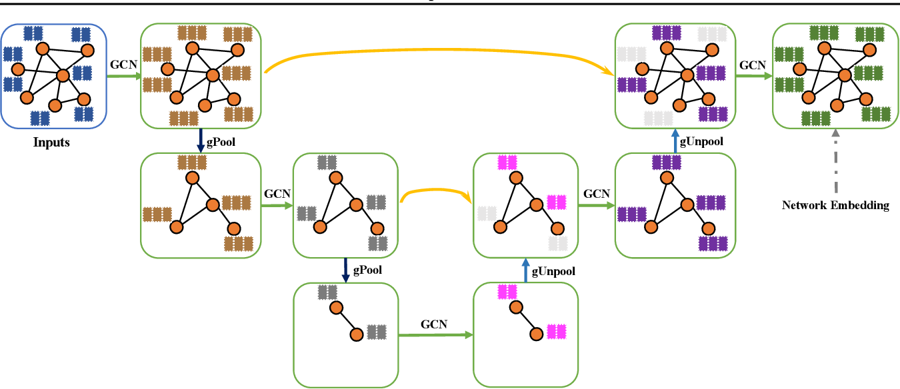
Graph U-nets
Notes:
וכילר

Slide 10
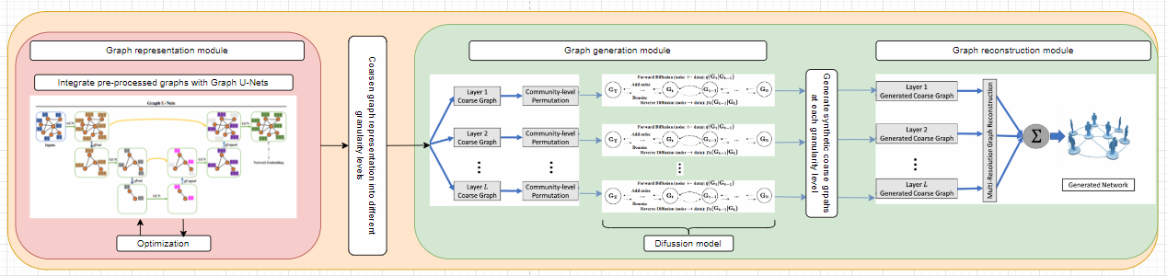
The model
The following image is the proposed model for the multi-scale graph generation using GU-net.
Notes:
וכילר

Slide 11
The model
Pre-process consists of data filtering.
Based on the architecture of the Misc-GAN model, the project also consists of three main modules:
Graph representation module
Graph generation module
Graph reconstruction module
Testing and evaluation are used to test the output graph employing various evaluation methods.
Notes:
דלאל

Slide 12
Graph representation module
The Graph Representation Module is employed in the first stage of the GU-net model, the encoder.
The model is trained on a given set of subgraphs of the predefined source graph (Source Style Graph)
The encoder process's output is a presentation of the input graph coarsened by various granularity levels, which is used in the diffusion process to simulate new components.
Notes:
דלאל

Slide 13
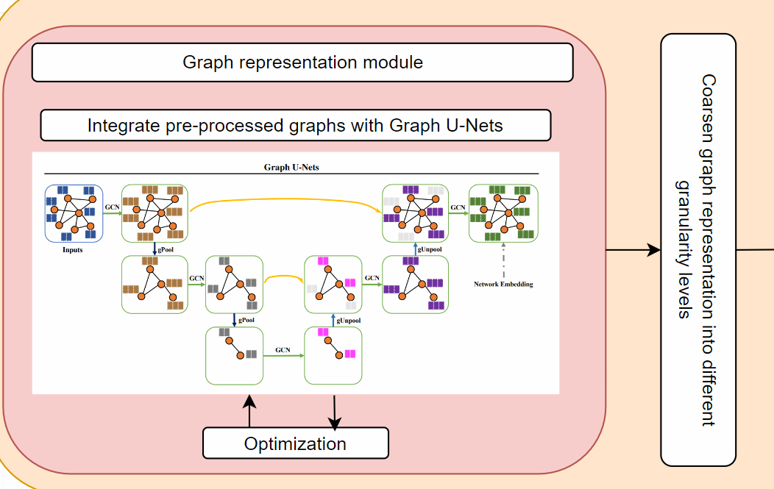
Graph representation module
In this module the graph objective is to train the model.
In this graph we have to tag the clusters.
Notes:
דלאל

Slide 14
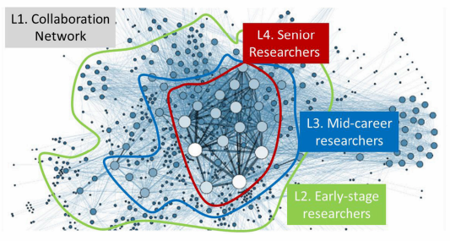
Example
This is an example represents module break down an input graph into different granularity levels:
The plot exhibits four-level hierarchies including (L1) all the entities in the collaboration network, (L2) early-stage researchers, (L3) mid-career researchers and (L4) senior researchers.
Notes:
דלאל

Slide 15
Graph generation module
This module facilitates the generation of target graphs from each coarsened graph at different granularity levels.
This module consists of three steps:
First step: Partitioning the graph into multiple non-overlapping subgraphs.
Second step: Characterize the community-level graph structures by Generating a set of block diagonal metrics from the detected communities.
Third step: Apply a diffusion model to generate a graph at each granularity level.
As a result, the module generates various target graphs, which are the basis of the input of the Graph Reconstruction Module.
Notes:
וכילר

Slide 16
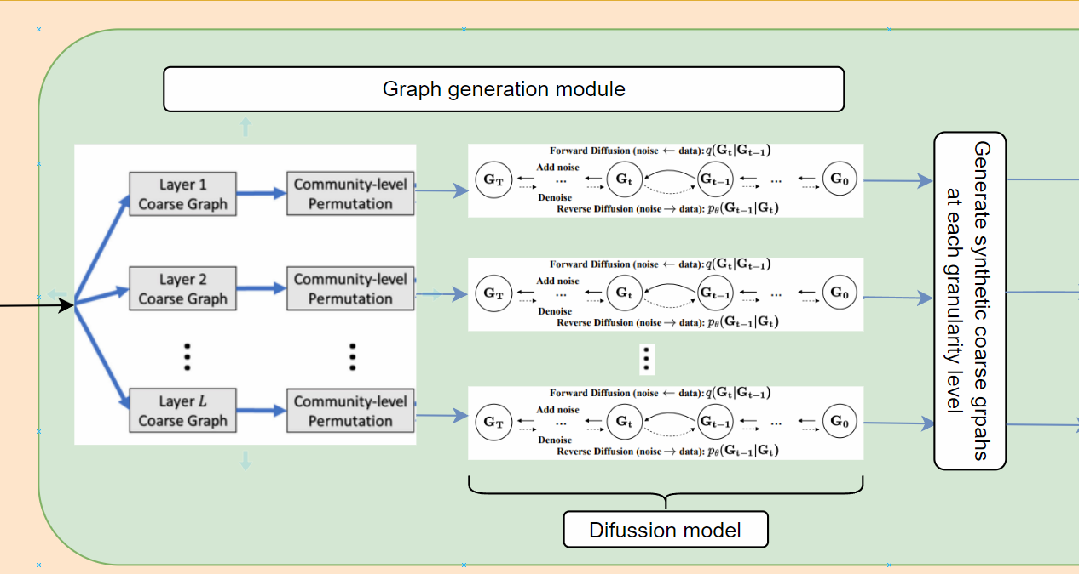
Graph generation module
Each coarsen graph is separately fed to the diffusion model.
Notes:
וכילר

Slide 17
Graph reconstruction module
The Graph Reconstruction Module is employed by the second stage of the GU-net model, the decoder.
The primary objective of this Module is to reconstruct a graph close to the original input graph from its coarsened representations.
Effectively reversing the coarsening operations performed during the encoding phase.
This is achieved through a combination of two key operations: gUnpool and skip connections.
Notes:
וכילר

Slide 18
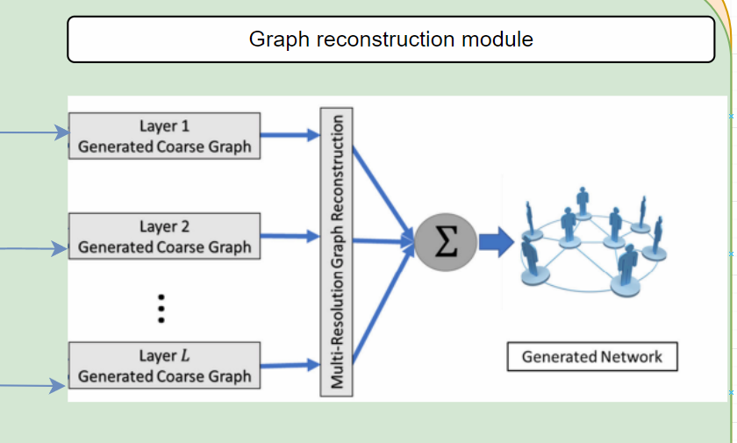
Graph reconstruction module
Combining all of the coarsen community graphs to restore the compressed graph.
Notes:
וכילר

Slide 19
Successes Evaluation
Previous models achieved somewhere between 67% - 84% similarity.
In order for the project to be successful it needs to achieve 85% similarity between the graphs.
If the result is less than 85% the model needs to be fine-tuned and further tests will be conducted.
The model will have the ability to generalize to new datasets and its performance compared to human-generated graphs.
Notes:
דלאל

Slide 20
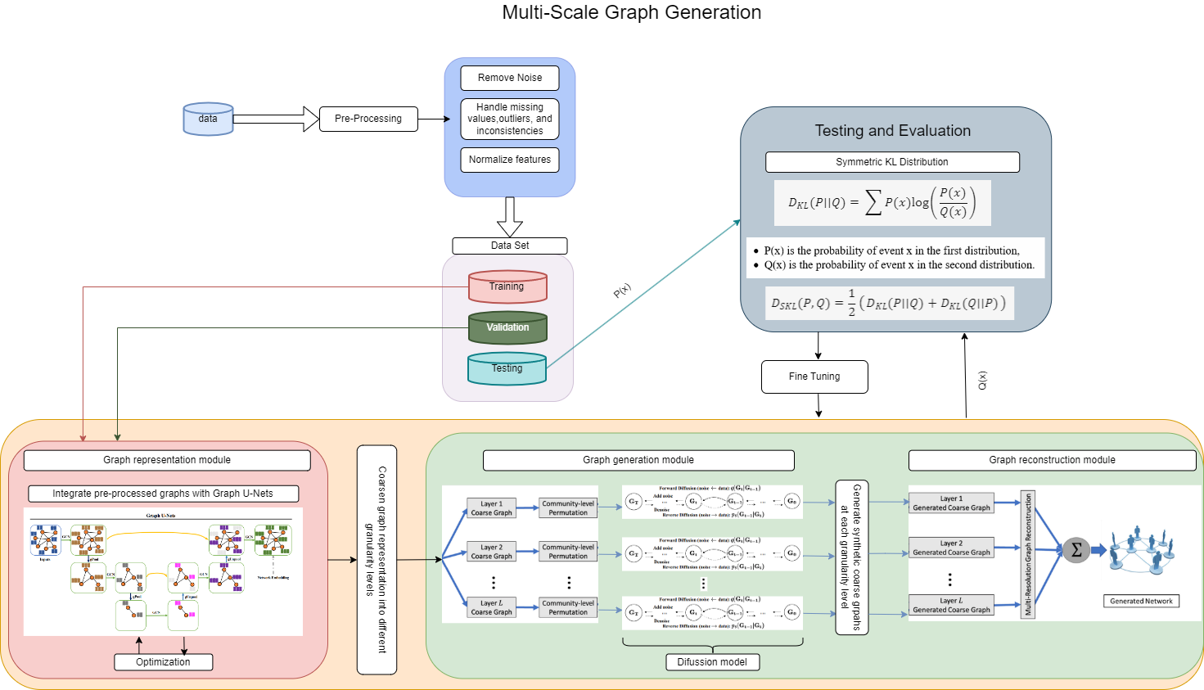
The general process
Below is the flow chart of the research model.
Notes:
דלאל

Slide 21
Testing plan
Test | Test Subject | Expected Result
1 | Graph Generation | The model will generate multi-scale graphs accurately based on the input.
2 | Graph Processing | The model will correctly process the generated graphs, capturing hierarchical relationships effectively.
3 | Graph Output Validation | The model will produce valid output graphs that accurately represent the hierarchical relationships in the data.
4 | Runtime Efficiency | The model will perform the graph generation and processing within an acceptable time frame.
5 | Input Size/Graph Size | The model will be able to handle larger graphs without a significant decrease in performance.
6 | Empty Graphs | If the input graph is empty, the model will return a specific error message indicating that the input graph cannot be empty. The model will not proceed with further processing until a valid graph is provided.
7 | Incomplete Graphs | If the input graph is incomplete (missing nodes or edges), the model will either return an error message or fill in the missing information based on predefined rules or assumptions.
8 | Incorrect Graphs | If the input graph is incorrect (contains invalid nodes or edges), the model will return an error message indicating the nature of the error. The model will not proceed with further processing until a valid graph is provided.
9 | Incompatible Graphs | If the input graph is incompatible with the model (for example, the graph is too large or the structure is not supported), the model will return an error message indicating the incompatibility. The model will not proceed with further processing until a compatible graph is provided.
10 | Generation Similarity Index | Similarity Index > 85%.
Notes:
דלאל

Slide 22
Conclusion
The incorporation of GU-Net and diffusion models offers a unique approach to capturing complex patterns within graph structures.
The main objective is to examine a new approach that aims to yield greater efficiency and accuracy than previous methods.
The project seeks to establish the proposed model as a better solution for multi-scale graph generation through careful testing and validation.
Notes:
דלאל

Slide 23

Thank you for listening!
Any questions?
Notes:
וכילר+דלאל

